Slide 1
Unit 2:
MAKING arrangementS
Today's lesson
Part: READ

Slide 2
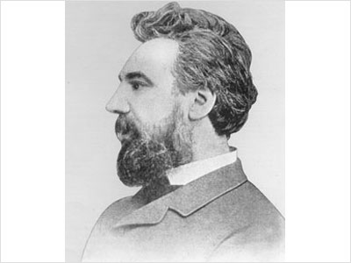
He’s Alexander Graham Bell
He invented the telephone
→He was a telephone inventor

Slide 3

I. New words
emigrate (v)
/ˈemɪɡreɪt/
= go to another country to live
: di cư
/trænzˈmɪt/
transmit (v)
: truyền, phát (tín hiệu)
conduct (v)
/kənˈdʌkt/
= carry out
: Thực hiện
deaf-mute (n) /ˌdef ˈmjuːt/
= a person can not speak and hear
: người câm điếc
device (n)
/dɪˈvaɪs/
: thiết bị
demonstrate (v)/ˈdemənstreɪt/
: biểu diễn

Slide 4
Ex.1:True/False statements prediction
T
F
a. Alexander G. Bell was born in the USA.
b. He worked with deaf-mute patients in a hospital in Boston.
c. Thomas Watson was Bell’s assistant.
d. Bell and Watson introduced the telephone in 1877.
e. Bell experimented with ways of transmitting speech
over a long distance.
f. Bell demonstrated his invention at a lot of exhibitions.

Slide 5
1.True/False. Correct the false sentences
T
F
a. Alexander G. Bell was born in the USA
√
→ Alexander G. Bell was born in Edinburgh.
b. He worked with deaf-mute patients in a hospital in
Boston
√
→ He worked with deaf-mute patients at Boston University.
c. Thomas Watson was Bell’s assistant.
√
d. Bell and Watson introduced the telephone in 1877
√
→ Bell and Watson introduced the telephone in 1876.
e. Bell experimented with ways of transmitting speech
between deaf-mutes over a long distance
√
→ Bell experimented with ways of transmitting speech
over a long distance.
f. Bell demonstrated his invention at a lot of exhibitions.
√

Slide 6
2. Put the events in the correct order.
Alexander Graham Bell …
a) went to live in the United States
b) successfully demonstrated his invention.
c) worked with Thomas Watson.
d) was born in Scotland.
e) went to live in Canada
f) invented the telephone.
g) worked with people who could neither speak nor hear
3-
7-
5-
1-
2-
6-
4-
neither … nor… : kh«ng … mµ còng kh«ng…

Slide 7
Homework :
Write a short paragraph about the invention of the
telephone.
Learn new words by heart.
Prepare the next lesson: Unit 2 : “Write” .

